Slide 1

C# Tips and Tricks

Slide 2
Table of contents
Traps
Syntactic sugar and Language Features in C#
Useful .NET classes and methods
Debugging and testing tips
Demos: https://github.com/NaskoVasilev/CSharp-Tips-and-Tricks

Slide 3

TRAPS

Slide 4
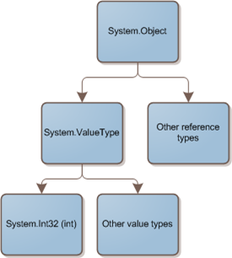
Equality in .NET
Value equality
The generally understood meaning of equality
Two objects contain the same value
E.g. two integers with the same value
have value equality
Reference equality
Also know as identity
Two objects references refer to the same object

Slide 5
Check references in .NET
To check for reference equality use ReferenceEquals (return Boolean)
Object.ReferenceEquals(firstObject, secondObject);
To check for value equality, you should generally use Equals
Equals as it is implemented by Object just preforms a reference check (we should override it)
firstObject.Equals(secondObject) // true or false
By default, the operator == tests for reference equality (override it for immutable types)
firstObject == secondObject // true or false

Slide 6
Comparing structs
All structs derive from the same ValueType class
ValueType.Equals(Object) overrides Object.Equals(Object) and provides default implementation of value equality
By default when comparing structs with Equals()
If none of the fields of the current instance are reference types => byte-by-byte comparison
Otherwise it uses reflection to compare corresponding fields (~20 times slower!)
We can improve the performance of structs by comparing them with overridden Equals

Slide 7
String References
String is a reference and immutable type
The CLR uses a method of storing only one copy of each distinct string value (string interning)
When apply += operator a new pointer to new string is created
Use StringBuilder for string manipulations
var string1 = "some value";
var string2 = "some value";
Console.WriteLine(ReferenceEquals(string1, string2)); // true
Console.Write("Please enter \"some value\": ");
var stringFromConsole = Console.ReadLine();
Console.WriteLine(ReferenceEquals(string1, stringFromConsole)); // false
var stringInternFromConsole = string.Intern(stringFromConsole);
Console.WriteLine(ReferenceEquals(string1, stringInternFromConsole)); //true

Slide 8
Preserving stack trace
These two same blocks simply re-throw the exception keeping the stack trace:
try { … } catch () { throw; }
try { … } catch (Exception e) { throw; }
The next block is different:
try { … } catch (Exception ex) { throw ex; }
It will change the source and the stack trace
It will appear that the exception has been thrown from the current method from that line
Prefer creating new custom exception

Slide 9
Exceptions & Static constructors
A static constructor is called automatically to initialize the class before:
The first instance is created
Or any static members are referenced
Once a type initializer has failed, it never retried (for the lifetime of the AppDomain)
Type will remain uninitialized
Creating instances will also fail
You should have a very good reason for throwing an exception from a static constructor

Slide 10
Virtual call in constructor
Calling virtual methods in a constrictor is a bad idea
When initializing a type in C# constructors are invoked top-down
First the top base constructor (object())
Then down to the derived constructors through inheritance
But virtual methods are invoked bottom-up
First the most derived overridden method
Then up to all base virtual methods
For this reason, if you call virtual methods in constructor, you may have unexpected behaviour from your classes

Slide 11
Changing Hash Code Run-time
Hash code is used in various hash-based collections (HashSet<T>, Dictionary<TKey, TValue>)
In C# an overridden method named GetHashCode provides the hash code generation for particular types
If you generate a custom hash code for a type, try to use read-only properties for it
Non-read-only properties may change the hash-code runtime and collections will not be notified for the change
Thus the internal structure and algorithms of the collection will not be able to retrieve and use the modified instance

Slide 12
Random numbers in .NET
The Random class in .NET is a pseudo-random number generator (deterministic)
Any instance of Random has certain amount of state (their seed value initially)
These two instances will generate the exact same values
var firstRandomNumberGenerator = new Random(0);
var secondRandomNumberGenerator = new Random(0);
RNGCryptoServiceProvider generates high-quality random numbers

Slide 13
LINQ Multiple enumeration
We are doing extra work by enumerating the collection twice in the two foreach statements
If GetDataObjects() results in a DB query, we are executing query twice with the same result
IEnumerable<DataObject> dataObjects = GetDataObjects();
foreach (var dataObject in dataObjects)
{
Console.WriteLine(dataObject);
}
foreach (var dataObject in dataObjects)
{
//do some other work here
}

Slide 14
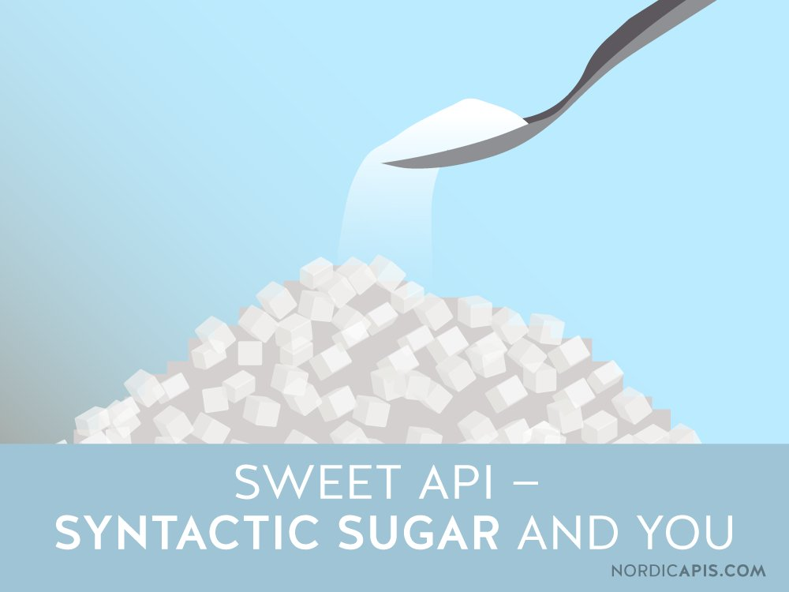
Syntactic sugar
Language features in C#

Slide 15
Casting vs the as operator
When casting from one type to another fails, the CLR will throw an exception
When using the as operator in case of fail, no exception will be thrown but the value will be null
The ‘is’ operator can check the type of variable
object number = “Five”;
var num = (int?)number; // InvalidCastException
// The next line will be evaluated without exception
var numberAsInt = number as int?;
// Here number as int will be null because the cast is invalid

Slide 16
Combinable enum values
Enums can store a combination of different values called bit-flags
Standard enums can support only one value
[Flags] allow us to have a combination of values
[Flags]
public enum Margins
{
None = 0, Top = 1, Left = 2, Bottom = 4, Right = 8
}
var bottomRigthMargin = Margins.Bottom | Margins.Right; // 100(2) = 4
bottomRigthMargin == Margins.Bottom; // False // 1000(2) = 8
bottomRigthMargin.HasFlag(Margins.Bottom); // True // 1100(2) = 12

Slide 17
Optional parameters
Optional parameters enable us to omit arguments for some method parameters
BankAccount(string accountHolder, decimal money = 1000) {}
The default value has to be a constant, parameterless constructor of value type or defaut(T) for some type T
When use them we should note that the default value is embedded in the caller’s assembly

Slide 18
Using yield
Using yield to define an iterator removes the need for extra class when implementing an IEnumerable
We use them in methods that return the type IEnumerable or IEnumerable<T>
public IEnumerable<int> EvenNumbers(int from, int to)
{
for (var i = from; i <= to; i++)
{
if (i % 2 == 0)
{
yield return i;
}
}
}
foreach (var number in EvenNumbers(50, 60))
{
Console.WriteLine(number);
}

Slide 19
Constraining generics
In generic classes we can apply restrictions to the type arguments
The type argument must be or derive from the specified base class or interface
class TemplateClass<T> where T : SomeClass
The type argument must be reference type (class) or value type (struct)
class TemplateClass<T> where T : class // where T : struct
The type argument must have a public parameterless constructor
class TemplateClass<T> where T : new()

Slide 20
Covariance and Contravariance
A generic type parameter can be one of:
Invariant (default) – meaning the generic type parameter cannot be changed
Contravariant – the generic type parameter can change from a class to a class derived from it
In C# we indicate this with the in keyword
Can appear only in input positions(method’s arguments)
Covariant – the generic type argument can change from a class to one of its base classes
In C# we indicate this with out keyword
Can only be return type of a method

Slide 21
Useful .NET Classes and Methods

Slide 22
The Tuple Class
A Tuple is a generic data structure that has a specific number and sequence of elements with overrided Equals, ToString, GetHashCode
Each element can have any type (e.g. int, tuple)
Tuples are immutable (read-only)
Tends to provide low-quality code
Useful for private methods (params and return values) and composite keys in dictionaries
var data = new Tuple<int, decimal>(4, 2.5M);
Console.WriteLine($"First value: {data.Item1}");
Console.WriteLine($"Second value: {data.Item2}");

Slide 23
C# 7.0 Tuples
C# 7.0 Tuples are types that you define using a lightweight syntax
Preferred over the Tuple<> class (better code quality)
They are structs (i.e value types)
They can have meaningful names for their fields
public (int Count, decimal Average) GetCountAndAverage(...)
{
return (4, 2.5M);
}
// var result = GetCountAndAverage();
// result.Count;
// result.Average

Slide 24
Method Deprecation
The [Obsolete] attribute in .NET marks a method that is about to be removed in future versions (a deprecated method)
The attributes generate a compiler warning
We can also generate a compiler error
It is a good practice to specify the new routine that has to be used in the message
[Obsolete("CreateXml() method is deprecated. Use CreateXmlReader instead.", false)] // true for compilation error
public void CreateXml() { }

Slide 25
File System Watcher
The System.IO.FileSystemWatcher class makes it possible to execute code when certain files or directories are created, modified, renamed or deleted
It listens to the file system change notifications and raises events
Few things to consider:
Sometimes events may be raised multiple times
The watcher will continue listening until the EnableRaisingEvents is set to false

Slide 26
Homogeneous Combinations
Concat() – concatenates sequences
Order of which sequence comes first matters
Union() – concatenates sequences without duplicates
Duplicates are determined by using IEqualityComparer<T> or Equals + GetHashCode()
firstList = { "apples", "bananas", "cherries", "durian" };
secondList = { "durian", "eggplant", "apples" };
PrintList(firstList.Concat(secondList));
// "apples", "bananas", "cherries", "durian", "durian", "eggplant", "apples"
PrintList(firstList.Union(secondList));
// "apples", "bananas", "cherries", "durian", "eggplant"

Slide 27
Homogeneous combinations (2)
Intersect() – subset of each collection that is found in both collections (i.e. common elements)
Except() – subtracts elements from a collection (i.e. first collection minus second one)
Both Intersect() and Except() depends on Equals() + GetHashCode() or IEqualityComparer<T>()
firstList = { "apples", "bananas", "cherries", "durian" };
secondList = { "durian", "eggplant", "apples" };
PrintList(firstList.Intersect(secondList)); // "apples", "durian"
PrintList(firstList.Except(secondList)); // "bananas", "cherries"

Slide 28
Heterogeneous combinations
Zip() – for each elements: combines element from the first sequence with element form the second sequence using result selector function
Aggregate() – Applies an accumulator function over a sequence
Built-in: Count, Min, Max, Sum and Average
firstList = { "apples", "bananas", "cherries", "durian" };
var listOfNumbers = Enumerable.Range(1, firstList.Count());
var newList = listOfNumbers.Zip(firstList, Tuple.Create);
// (1, apples), (2, bananas), (3, cherries), (4, durian)
Console.WriteLine(firstList.Aggregate((s, c) => s + c););
// applesbananascherriesdurian

Slide 29
Debugging and testing tips

Slide 30
Test Internal/Private Members
Easiest way out is to make the members public
Make the members protected and have the unit test class extend this class to gain access
Use reflection to invoke the members
Use InternalsVissibleTo for internal members
[assembly: InternalsVisibleTo(string assemblyName)]

Slide 31
Debugger Visible Display
Controls how debugger variables look like
When overridden, ToString is used in the debugger variable windows for classes
DebuggerDisplay controls how a class or field is displayed in the debugger variable windows
[DebuggerDisplay(“Student named: {FirstName} {LastName}”)]
DebuggerBrowsable determines if and how a member is displayed in the debugger variable windows (values: Never, RootHidden)
[DebuggerBrowsable(DebuggerBrowsableState.Never)]

Slide 32
Caller info Attributes
Inject code properties during compile-time
CallerMemberName attribute will inject the name of the method/property that is calling the method
GetCallerMemberName([CallerMemberName]string memberName = null)
CallerFilePath attribute will inject the file path of the code file in which the caller is located
GetCallerFilePath([CallerFilePath]string filePath = null)
CallerLineNumber attribute will inject the line number in the code file, in which the caller is located
GetCallerLineNumber([CallerLineNumber]int lineNumber = 0)

Slide 33
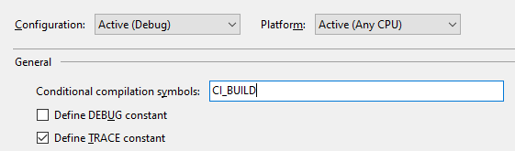
Preprocessor symbols
Conditional compilation directives make it easy build varying versions of an application by varying the preprocessor symbols
#if, #elif, #else and #endif control the conditional code execution
#if DEBUG
// Debug build
#elif CI_BUILD
// CI_BUILD is set
#else
# error Neither DEBUG nor CI_BUILD
#endif

